Slide 1

Chinese Immigration to Barbados
巴巴多斯
華人移民
GEOG 496 Research Project
Ethan Bird, Yanbing Chen, Olivia Kennedy

Slide 2
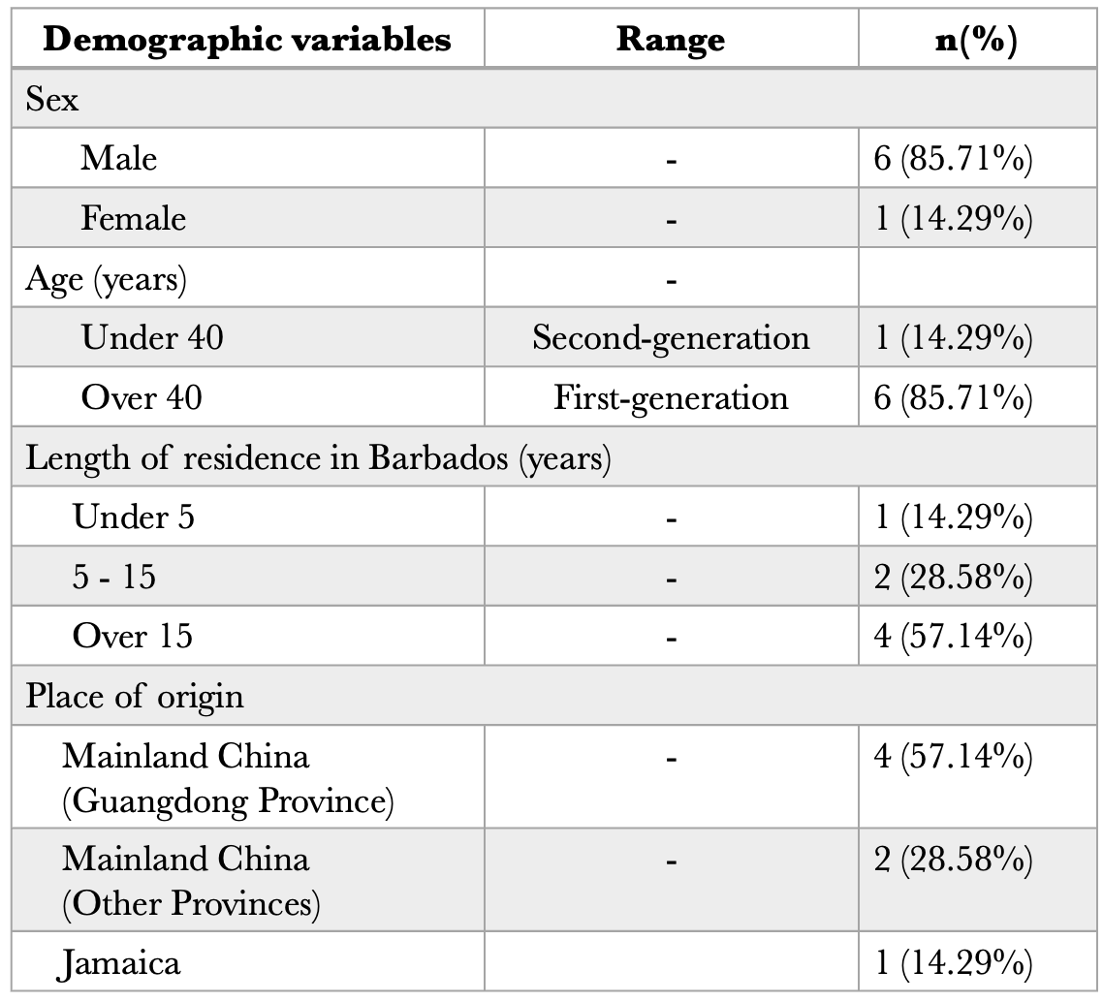
Demographics Information of Study Participants （N = 7)

Slide 3
Chinese Immigrants in Barbados: A Small Community
A total population of around 200 individuals
Most come from coastal provinces: A lot of them from Guangzhou, Baiyun District
Some arrived Barbados through personal network
Others came from different Caribbean islands
Restaurateurs, construction workers, teachers in Confucius Institute… and more!

Slide 4
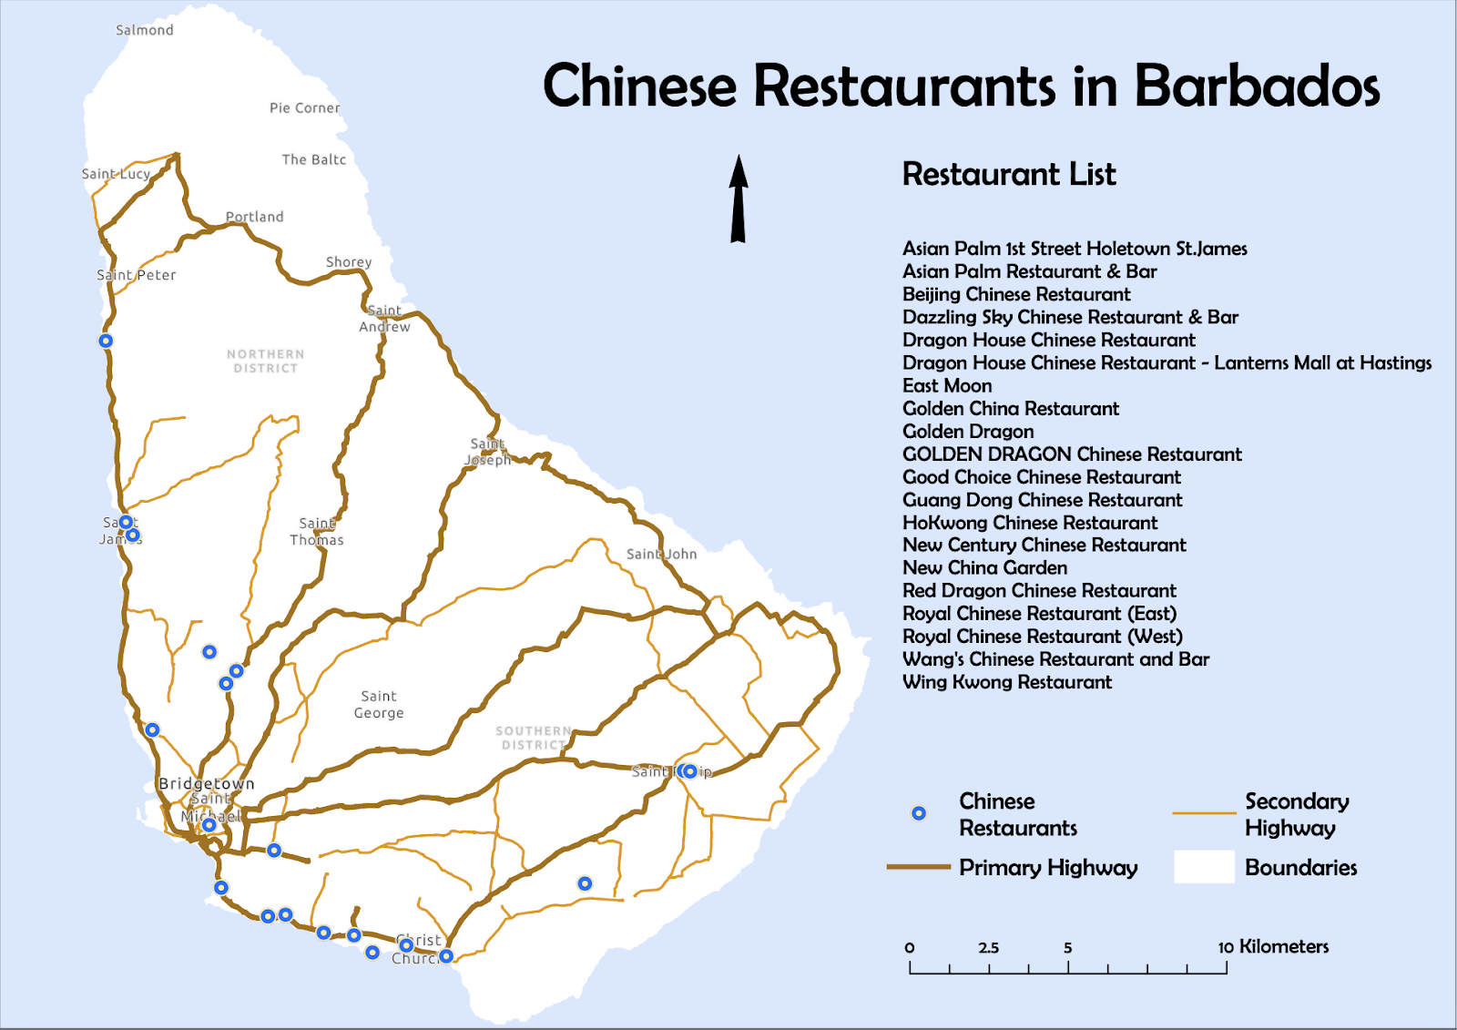

Slide 5
Challenges
Barbadian citizenship: A long way to go
Language Barrier: A hurdle few tried to cross
The Diminished Safety of Chinese Immigrants in Barbados

Slide 6
Quotes
Hearing from informants directly

Slide 7
Discrimination and Hostility
“They aren’t outright racist, but when COVID happened so many people from the Confucius Institute experienced comments like ‘it’s the China Virus.’ People would do this, but still say they’re not racist.”
-Second generation Chinese-Barbadian

Slide 8
Isolation/Difference
“If you are not in other country, maybe you never feel how to love your country”
“Because, an example here, whenever something happens in China, people talking, ‘oh, you are China!’ Everything put on myself, good or bad. They don’t care about your feelings because it’s ‘my country, why you here?’ Everywhere you go, people want to push you out. Everywhere, when you talk, you’re Chinese, you’re different.”
-Chinese farm owner, Saint Andrew

Slide 9
Sense of Belonging and Changing Identities
“[one initiative] is the annual Fish and Dragon Festival. It aims to show the fusion between Chinese and Barbadian culture. The national identity is changing, it’s not just predominantly African. While there’s nothing wrong with that being the majority, it’s not the only one. [I hope] that the response will continue to evolve and change to where the average Barbadian doesn’t see a Chinese person as completely separate and foreign to the locale and that it becomes more fused.”
--Second-generation Chinese Barbadian

Slide 10
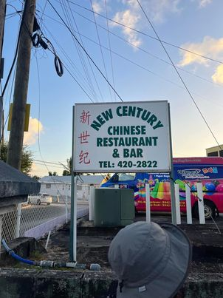
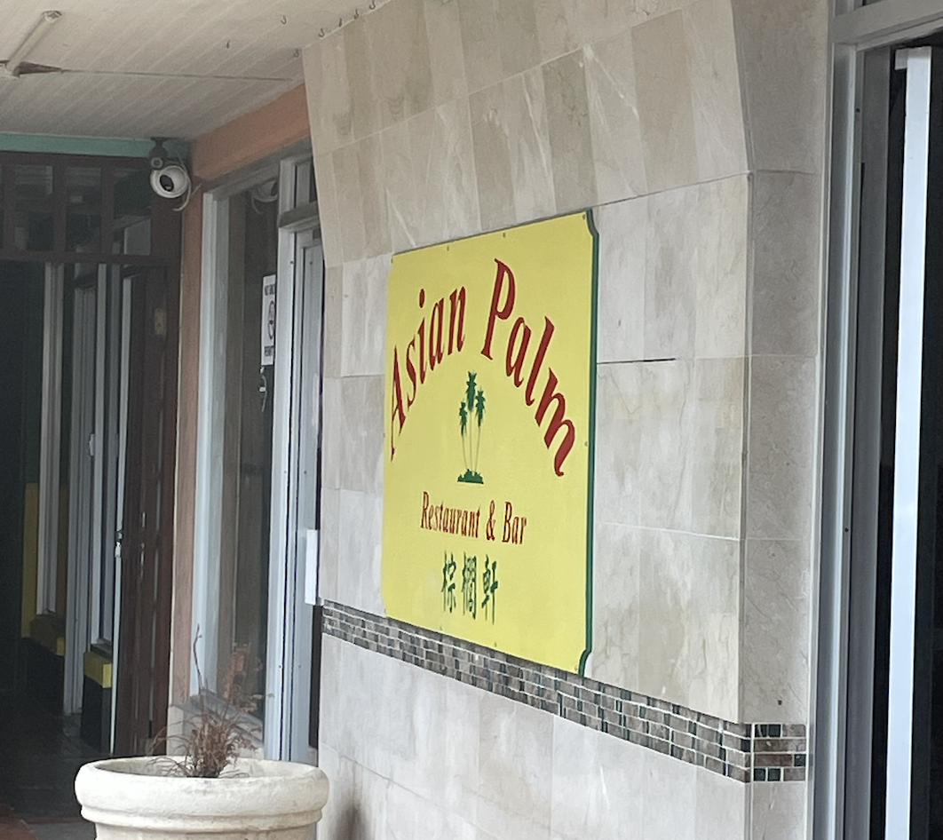
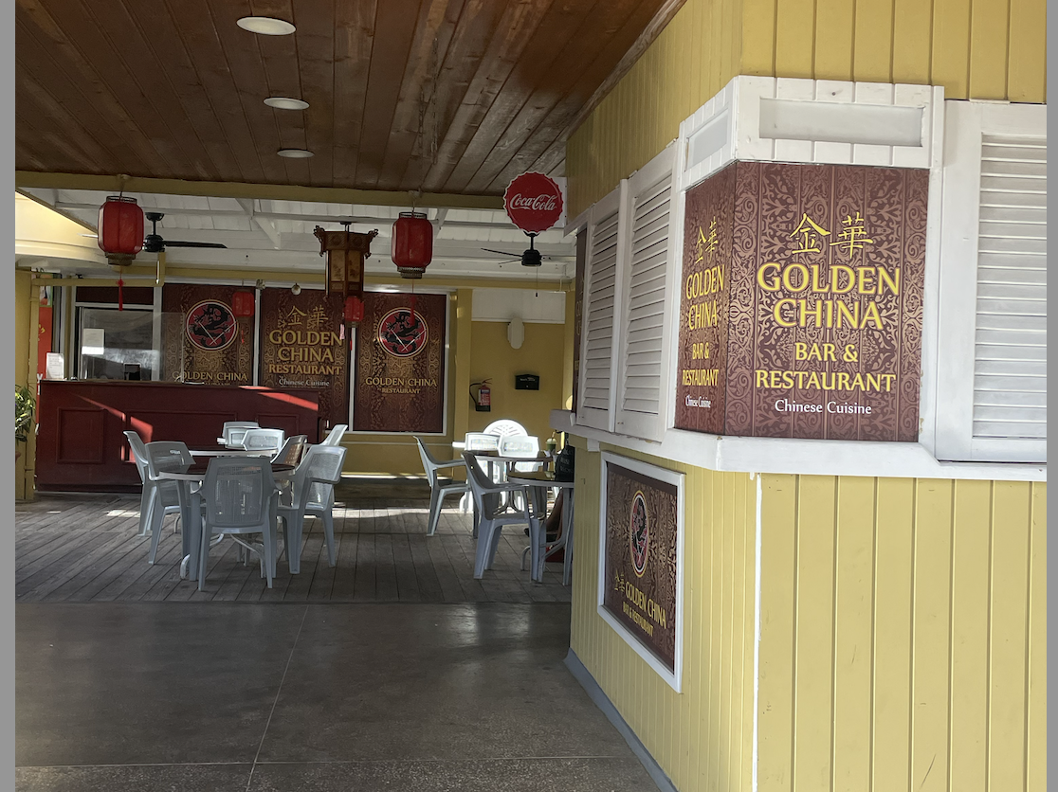
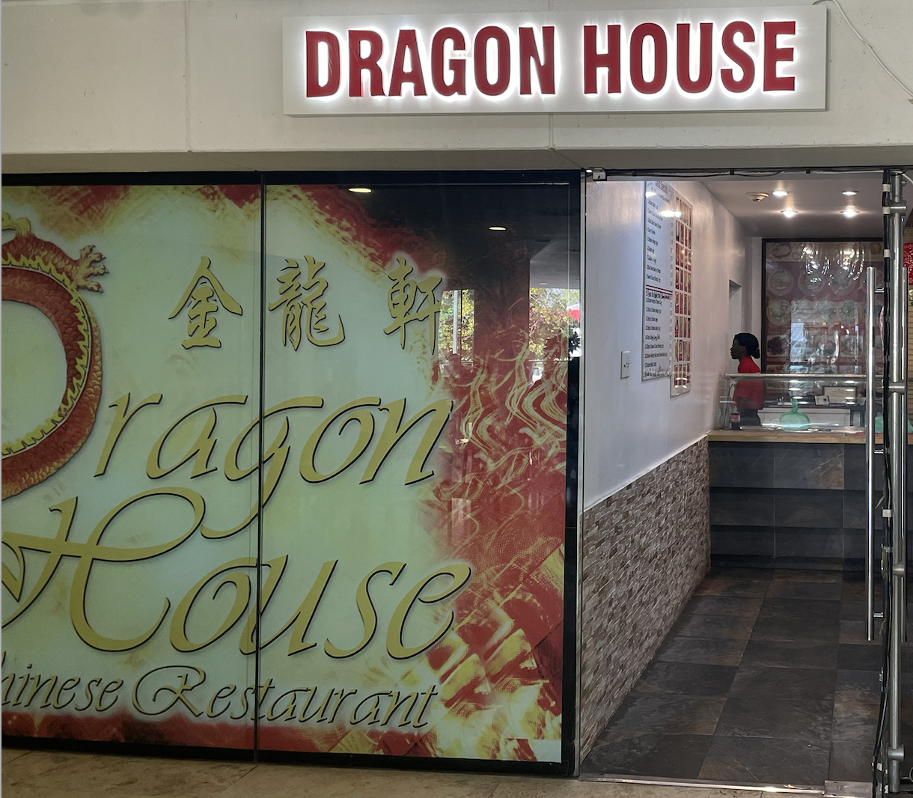
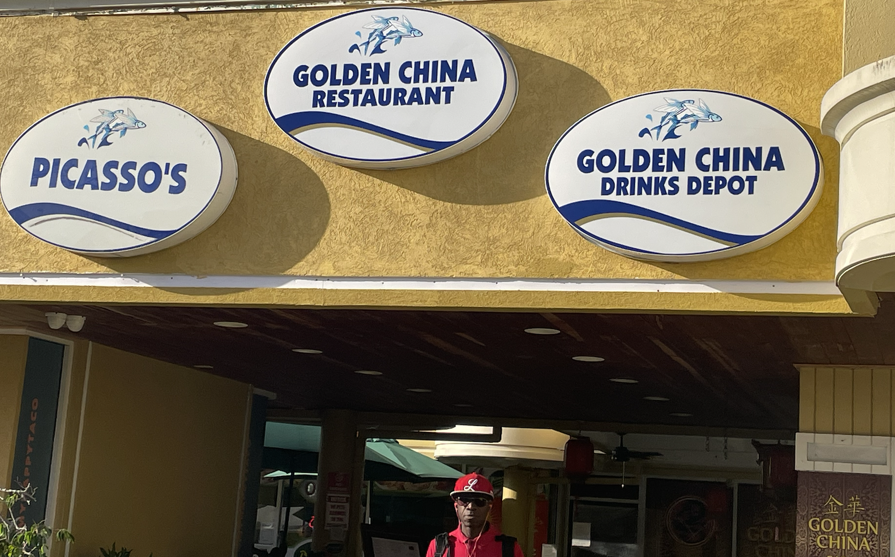
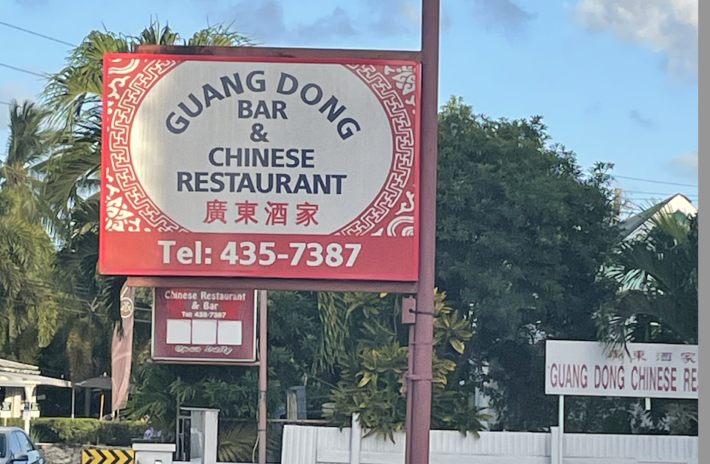
Chinese Restaurants!

Slide 11
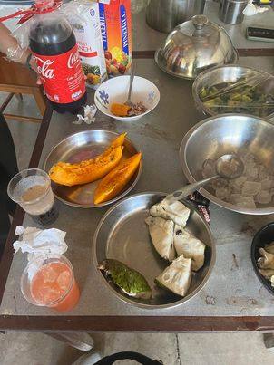

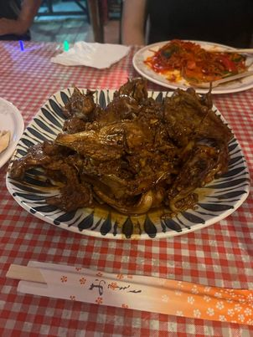
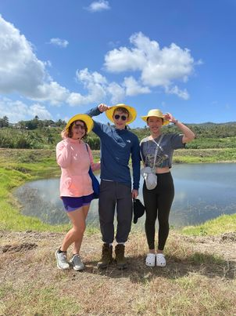
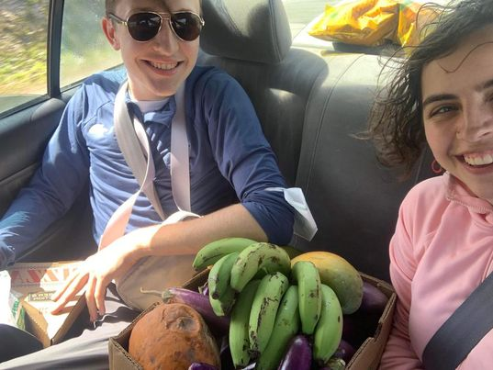
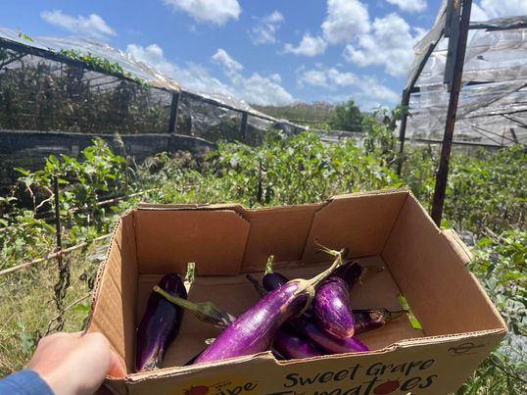

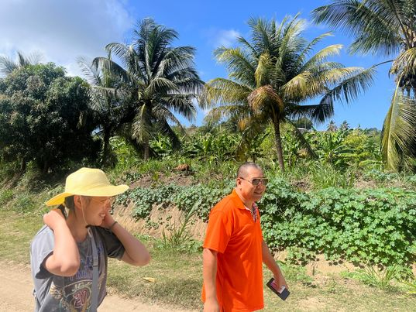
In the Field!

Slide 12
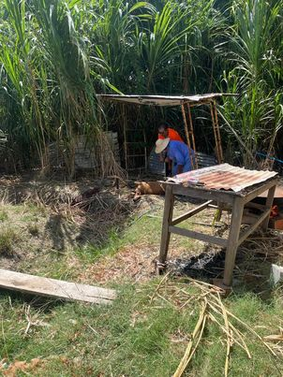

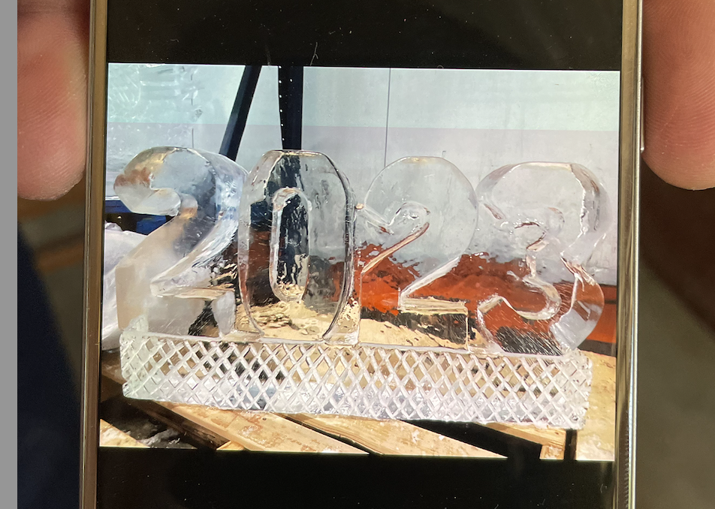
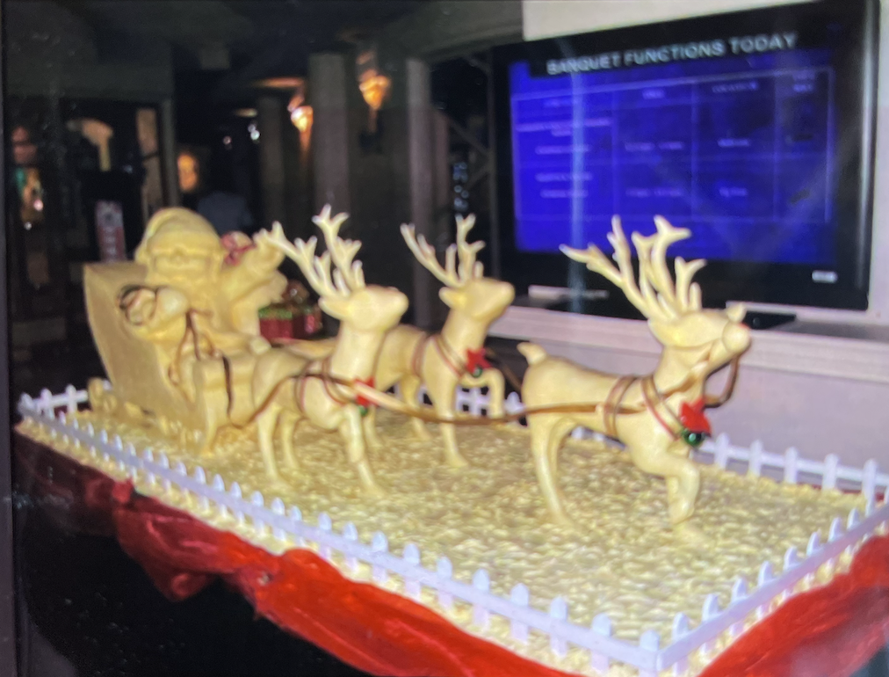
More photos…

Slide 13
Conclusions
Diversity within the Chinese community
Dividers: language, occupation, old vs new migration waves, regional divides
Key motivators: weather, culture, and business opportunities
Challenges and resiliency
Community is getting smaller, outmigration
Other efforts/organizations to improve visibility: Beijing to Bridgetown Project, Barbados Museum and Historical Society, Confucius Institute, Chinese Association of Barbados

